Slide 1
CardioAlex in a box
State of the Art
Mohamed LOUTFI, MD

Slide 2

Glu (Cyanoacrylate) Septal Ablation:A new hope for the treatment of HOCMP
Prof Ali Oto,MD,FESC,FACC,FHRS
Hacettepe University Faculty of Medicine,Department of Cardiology
Ankara

Slide 3
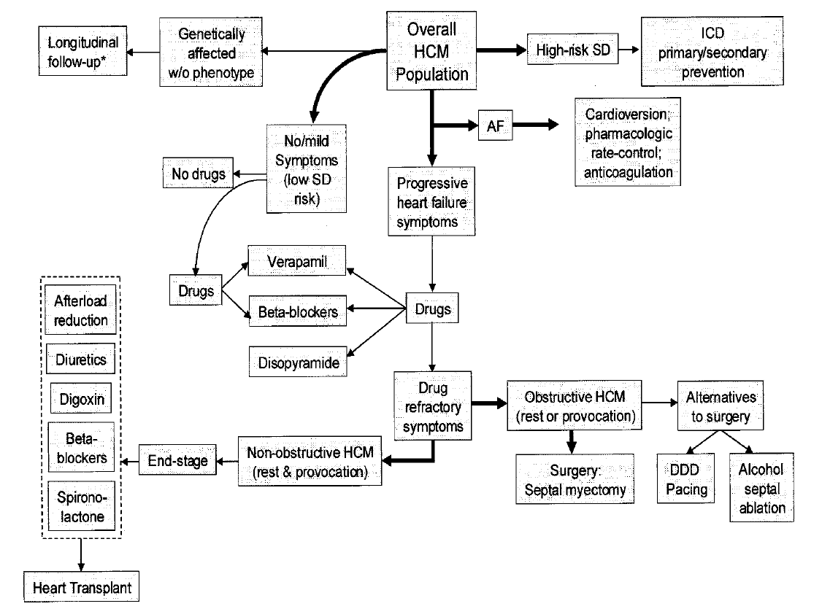
Glue septal ablation

Slide 4
CONCLUSIONS
GSA is a promising alternative for the treatment of patients with HOCM. Our experience suggests that GSA is effective,safe and can be performed without serious complications.
Glue seems to be superior to alchol ; immediate freezing prevents leakage to LAD and thought to be particularly useful in the presence of collaterals.
For long-term safety anf efficacy more studies are needed .

Slide 5
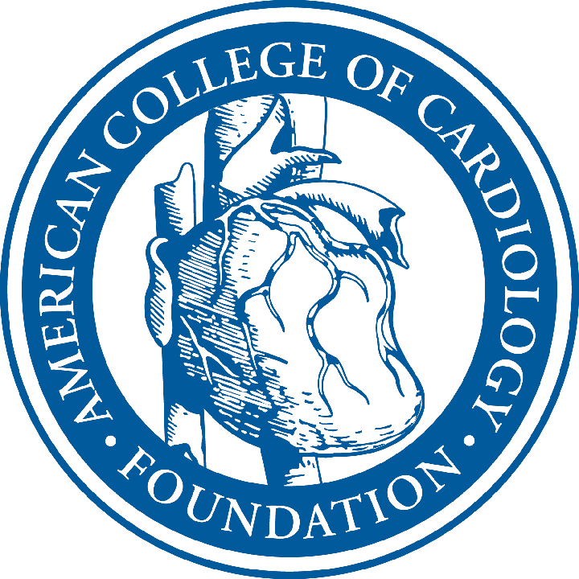


Low Gradient Aortic Stenosis
Caveats & Pitfalls
William A. Zoghbi MD, FACC
President, The American College of Cardiology
Director, Cardiovascular Imaging Institute
William L. Winters Endowed Chair in CV Imaging
The Methodist DeBakey Heart & Vascular Center
No conflicts to report

Slide 6
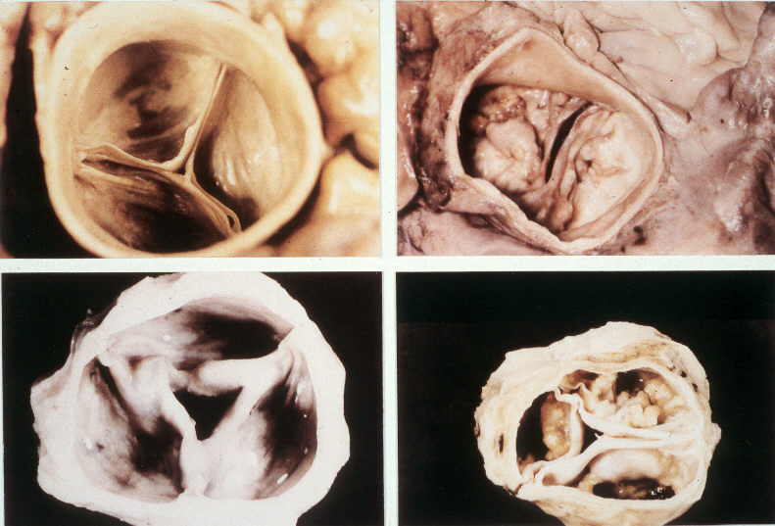

Slide 7
Fit for life – promoting cardiovascular health
Professor David A Wood
Garfield Weston Professor of Cardiovascular Medicine
Honorary Consultant Cardiologist
Imperial College
London UK

Slide 8
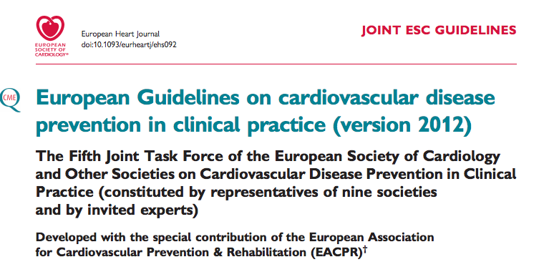

Slide 9
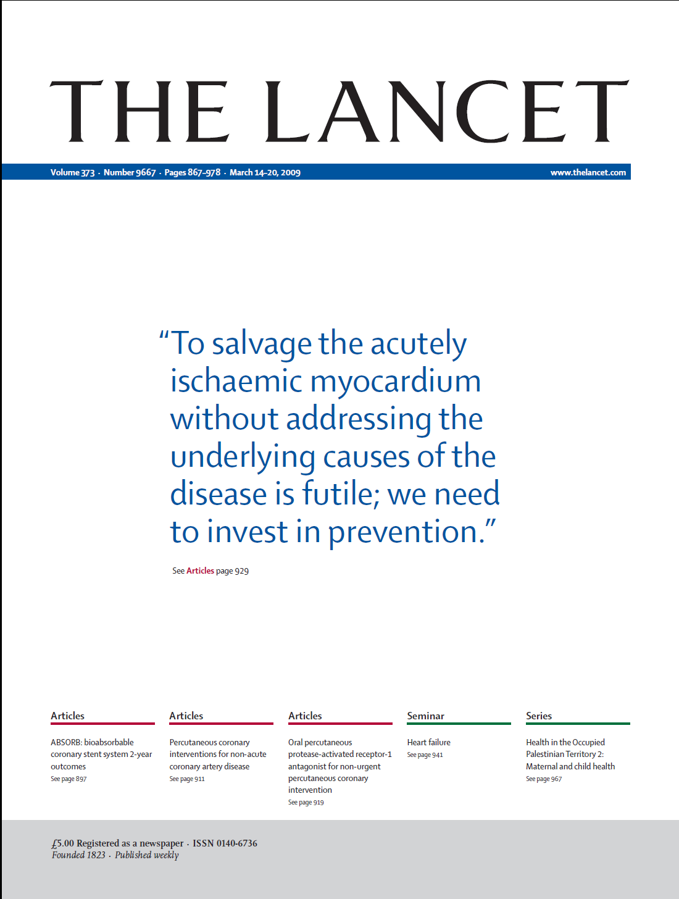

Slide 10
Intervention + Prevention

Slide 11
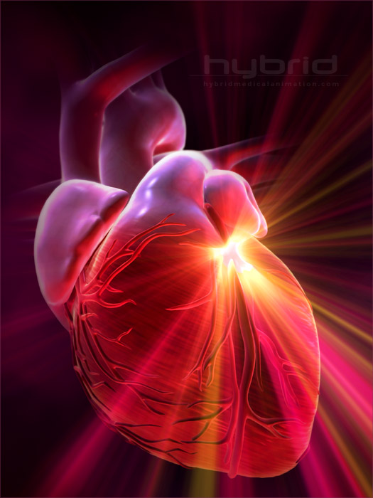
Non Operable Diffuse
Small Vessel disease the interventional options
Dr Mohammad I Kurdi. MBBS.FRCPC.FSCAI.
Interventional Cardiology Consultant
Al Habib Medical Group
Altakhassoussi Hospital
Riyadh Saudi Arabia

Slide 12
Conclusion
Small vessel with diffuse disease and tortousities , the option of POBA is still reasonable option and with the introduction of the new DEB it give better result than the DES .
DES will remain the option of choice for the Proximal large vessel .
In diffuse vessel disease combining both technique with proximal stenting and careful selected angioplasty of the distal vessels should be studied more .

Slide 13
Revascularization in Complex and High Risk Patients
CARDIOALEX 2012
Alex 5-8 June 2012
Walid Hassan, MD, FAHA, FACC, FACP, FCCP, FSCA&I
Professor of Medicine
Texas Heart Institute
Houston, Texas

Slide 14
Risk Assessment in the PCI Patient
Complex Interplay of…
Patient related risks
Diabetes Mellitus
Renal Disease
Heart Failure
Gender
Elderly
Procedural/ lesion
related risks
Clinical
presentation
Unprotected LM
SVG
Bifurcations
CTO
Multivessel PCI
AMI
Shock
ACS

Slide 15
Patients at risk
Age >65 y/o
Women
Previous angina, MI, CHF
DM, CRI
Stroke or PVD
Chronic occluded vessels
LAD-MI
Multivessel CAD
LVEF <35%
High filling pressures

Slide 16
Summary:
Revascularization Decision Factors
ACS
Clinical Presentation
Stable Angina
Silent Ischemia
Multivessel
Left Main
Anatomic Factors
Single Vessel
Patient
Other Factors
Lesion
Operative risk
Compliance
Co-morbidities
Location
Complexity
Complication Risk

Slide 17
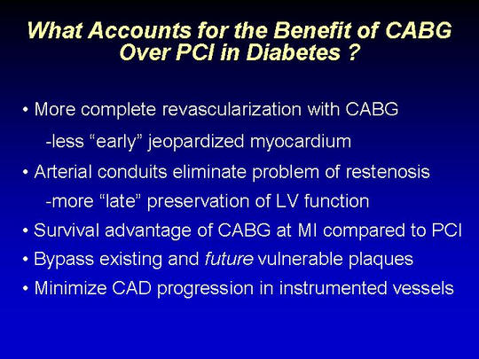

Slide 18

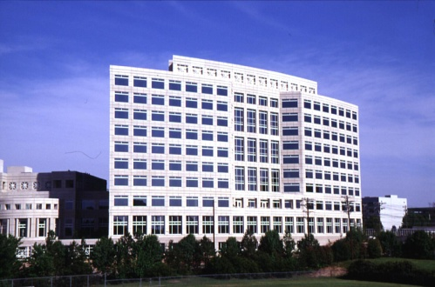
DES Designs:
Can We Tell “Newer” From “Better”?
Mitchell W. Krucoff MD
FACC, FAHA, FSCAI
Professor of Medicine / Cardiology
Duke University Medical Center
Director, Cardiovascular Devices Unit
Duke Clinical Research Institute

Slide 19
Is “Newer” Always “Better”: Conclusions
Engineering & design objectives are the key to better, safer DES
Design endpoints range from procedural (deliverability) to biological (late loss, endothelialization) to clinical (angina, MI, ST, death)
Design targets include novel aspects of stent platform, drug and drug delivery systems
DES is a “combination product” where changes to one component may affect others--small changes to strut thickness & geometry, polymer, drug, dose and kinetics may result in big outcome changes, for better or for worse.
Achieving novel design changes is not enough until clinical data confirm better outcomes

Slide 20
Day 3
Hall: Middle
8:30 -10:00 State of the Art 4
Chairpersons
Khairy Abdel Dayem
Medhat El Ashmawy
Mohamed Abdel Ghany
Mohamed Attia
Mohamed Sobhy
Ossama Sanad
8:30 - 8:45 Strategies for STEMI treatment
Bernard Chevalier France
8:45 - 8:48 Discussion
8:48 - 9:03 Revascularisation guidelines: US vs EU
William Wijns Belgium
9:03 - 9:06 Discussion
9:06 - 9:21 Drug eluting stents: can we tell "newer"
from "better"?
Mitchell W. Krucoff USA
9:21 - 9:24 Discussion
9:24 - 9:39 Left Atrial Appendage Occluder device a
novel approach to prevent Strokes in
Non Valvular Atrial Fibrillation
Samih Lawand Saudi Arabia

Slide 21
WATCHMAN Left Atrial Appendage(LAA) Occluder for Stroke Prevention in Lone Atrial A Single Center ExperienceFibrillation
Samih Lawand MD
Consultant Interventional Cardiologist Head CCU
King Fahad Medical City
Riyadh/KSA
Faisal Samadi MD FRCPC, Samih Lawand MD FRCPC, FACC, Tariq Kashour MD FRCPC,

Slide 22
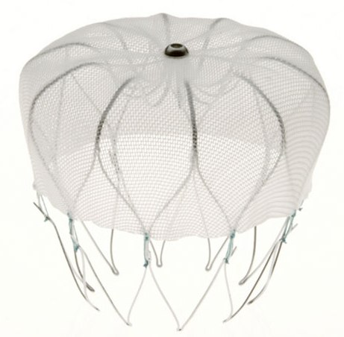
LAA CLOSURE DEVICE
IN PRACTICE
Notes:
Bism ellah
I would like to thank the orgnizing committee for inviting me to speak, it is a pleasure and an hounor

Slide 23
CONCLUSION
As published:
LAA device closure (in AF patients who are candidates for warfarin) is associated with a reduction in hemorrhagic stroke risk vs warfarin.
Rates of all-cause stroke and all-cause mortality were noninferior to warfarin, whereas safety events (pericardial effusion) were more common in device group.

Slide 24
CONCLUSION
Closure of LAA might provide an alternative strategy to chronic warfarin therapy for stroke prophylaxis in patients with nonvalvular AF.
(TECHANICAL DIFFICULTIES)
? New anticoagulation drugs: Dabigatran, Rivaroxaban

Slide 25
CardioAlex June 07, 2012
Myocardial Revascularisation
ESC vs US Guidelines
William WIJNS
Aalst, Belgium

Slide 26
ESC vs US Guidelines
Why there should be differences!
Guidelines preparation and publication are not synchronous between US Societies and between ACC, AHA and ESC
Differences in recommendation level and strength are to be expected given evolving evidence and/or experience

Slide 27
ESC vs US Guidelines
As a result of the above, ESC Guidelines cannot possibly account for all these differences and should offer “generic” statements, based on scientific evidence and expert experience
Recommendations in ESC Practice Guidelines are relevant to optimal care delivery scenarios
  Useful to leverage change in suboptimal environments
  “Generalizable” and less system-specific than US documents
  No legal value (disclaimer)

Slide 28

How to treat inDES restenosis:
DES? Balloon? DEB?
B. Chevalier, MD, FESC, FACC, FSCAI
ICPS, Massy, France

Slide 29
Conclusions
InDES restenosis is unfrequent and selects different population than BMS restenosis
SES is superior to plain balloon except for late loss
Role of DEB remains unclear
Future role of absorbable DES ??

Slide 30
Nobori DES – Clinical Update
Bernard Chevalier
ICPS Massy
France

Slide 31
Conclusions
Results of both selected and real life patients are very encouraging
Results are consistent in various geographic areas and patient subsets
Particularly appealing are results in AMI, Bifurcation, Small Vessels, and Diabetic Patients
Extremely low rate of late and very late stent thrombosis appears to confirm hypothesis about long term safety of DES with abluminal coating & biodegradable polymer

Slide 32
CARDIO ALEX 2012
Alexandria, Egypt, June 5 – 8, 2012.
15 min + 7min
Renal Denervation:
New Devices on the Horizont
.
Horst Sievert,
Jan Kulow, Ulrike Jost, Ann-Kathrin Ziegler,
Ilona Hofmann, Undine Pittl, Laura Vaskelyte
CardioVascular Center Frankfurt,
Frankfurt, Germany

Slide 33
New devices
Radiofrequency catheters
  St. Jude Medical
  Cordis
Radiofrequency balloons
  Covidien – Maya
  Vessix Vascular
Nano particles
  Apex Nano
Drugs
  Mercator
  Kipprokration Hospital, Athens
Ultrasound
  Recor Medical
  CardioSonic
  Sound Interventions
  Kona
Radiation
  Best Medical Int.

Slide 34
Clinical Relevance of OCT
Optical Coherence Tomography
CardioAlex XII
June 07, 2012
W Wijns
Cardiovascular Center, Aalst, Belgium
Notes:
34

