Slide 1
Coronary Atherosclerosis is a progressive disease

Slide 2
Atherosclerosis is a disease of large and medium sized muscular arteries is characterized by the following:
. Endothelial dysfunction.
. Vascular inflammation.
. Build up of lipids, cholesterol, calcium, and cellular debris within the intima of the vessel wall.

Slide 3
Atherosclerotic buildup over years results in the following:
Plaque formation.
Vascular remodeling.
Acute or chronic luminal obstruction.
Abnormalities of blood flow.
Diminished oxygen supply to target organs.

Slide 5
Case presentation 85 ys lady Professor of literature long history of CAD (30 years) 6 Coronary angiography 2 CTA 2 CABG 2 PCI Presented two weeks ago with ACS

Slide 6
1981
56 years old female
Recurrent attack of anginal pain
Risk Factors: Obesity.
ECG: normal.
Responded to medical treatment

Slide 7
1982
She had discovered
congenital absence of the left kidney.
Hypertension.
Dyslipidemia.
No chest pain on medical treatment
No further study

Slide 8
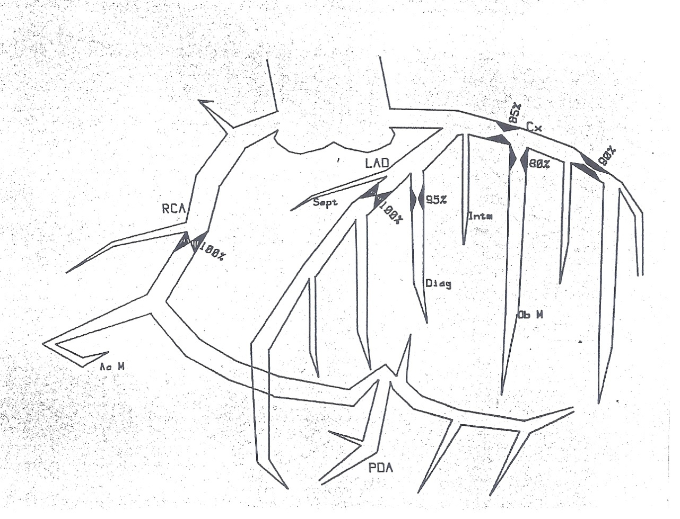
1984
Acute inferior STEMI
Her 1st CORONARY ANGIOGRAPHY was done
LM: normal.
LAD: total occluded
LCX: 85% lesion
RCA: mid segment total occluded

Slide 9
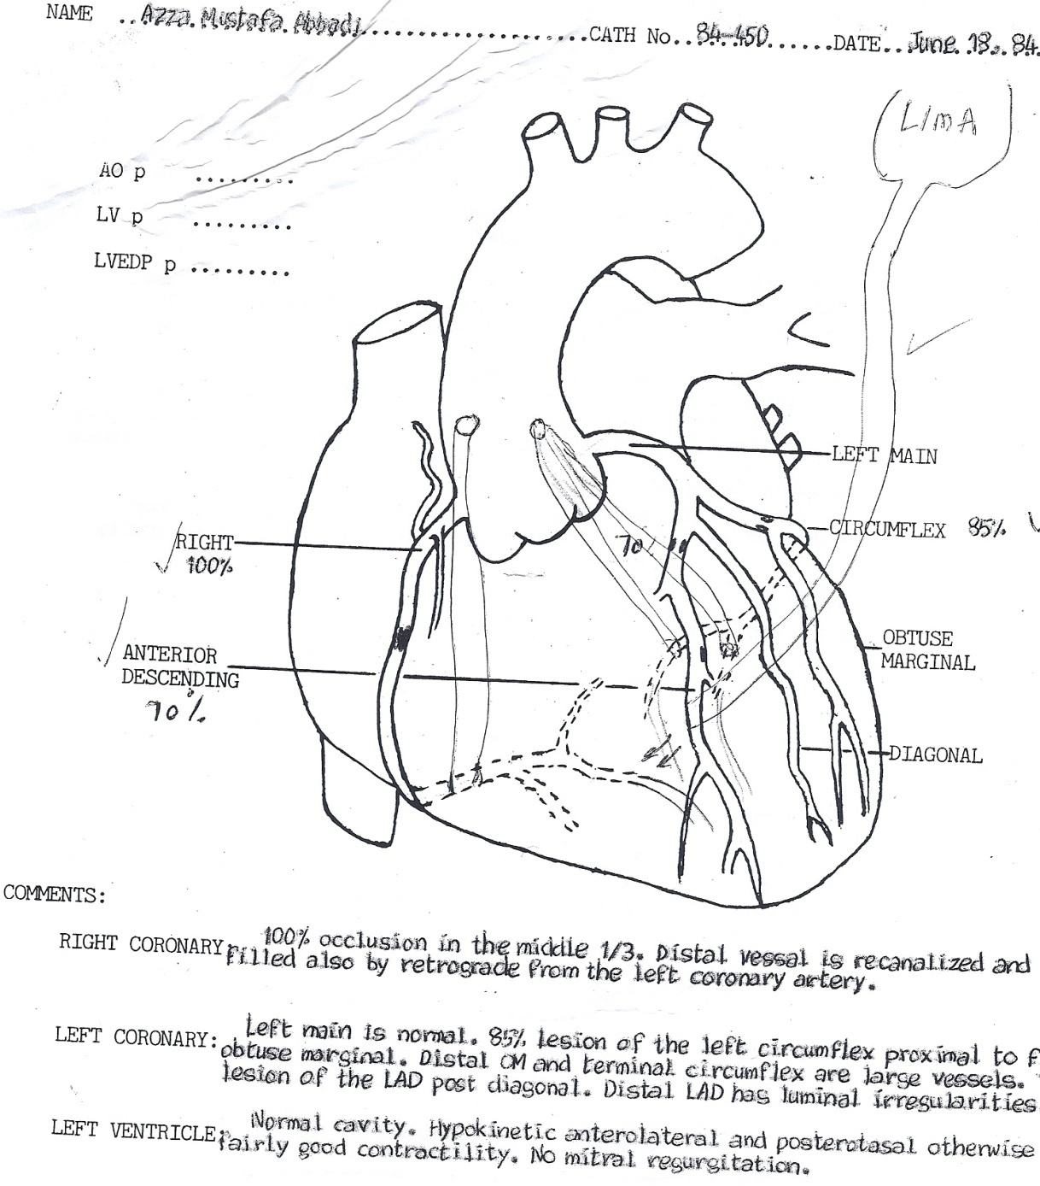
Aug-1984
CABG was done
4 grafts
LIMA ----LAD
SVG -----OM1
SVG----OM2
SVG ----PDA

Slide 10
Jan-1990
Asymptomatic for 6 years
Recurrent chest pain
Coronary angiography (2nd ) was done revealed:
Patent grafts with mild disease.
Some progression of disease in diagonal branch
Good LV function.
Responded to medical treatment
Angina free 4 years.

Slide 11
April-1994
Recurrent chest pain
3rd Coronary angiography was done showed:
Patent LIMA – LAD.
Occluded grafts to OM1, OM2.
Redo CABG venous grafts to OM and Diagonal vessels.
8 years angina free.

Slide 12
2002
Age: 75 ys
Recurrent chest pain
4th Coronary angiography
Occluded OM grafts
PCI OM two BMS stents
6 years angina free.

Slide 13
2008
Age 82 ys
Recurrent chest pain
CTA MDCT 64 study revealed:
LAD: Subtotal occlusion
LCX: Patent stent.
RCA: Total occlusion.
Grafts: LIMA LAD patent
SVG- PDA: proximal obstructive non calcified lesion

Slide 14
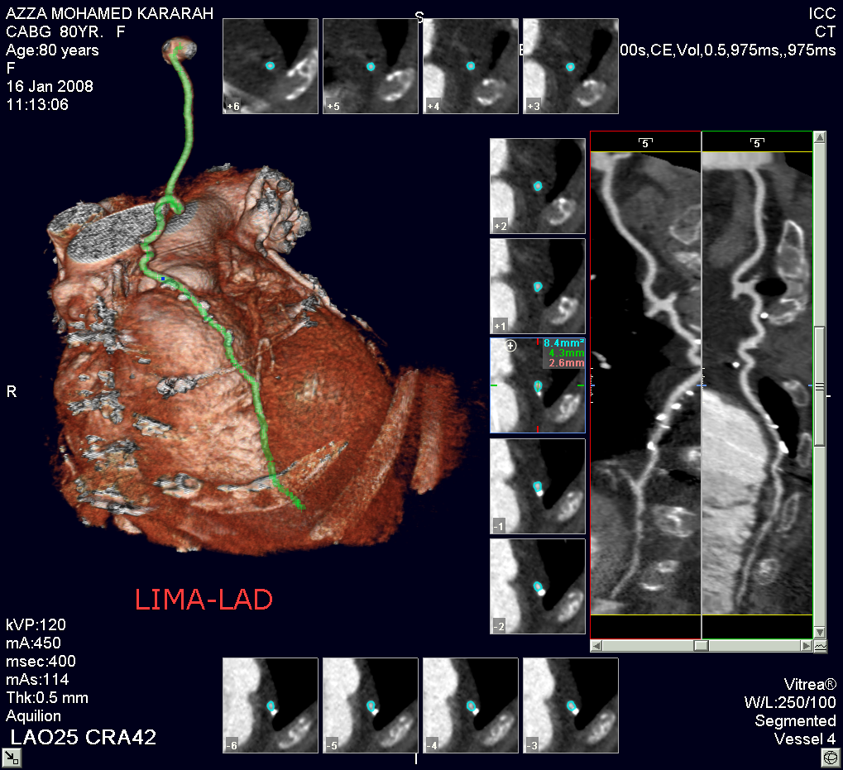

Slide 15
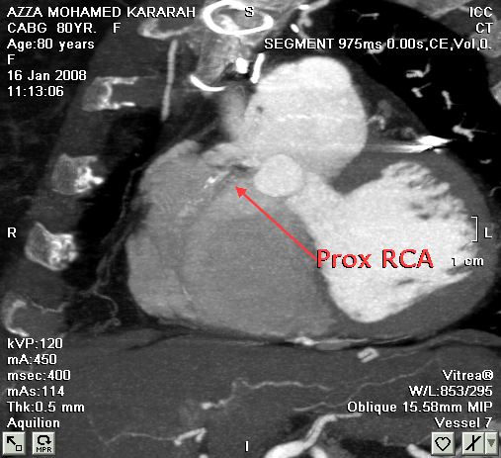

Slide 16
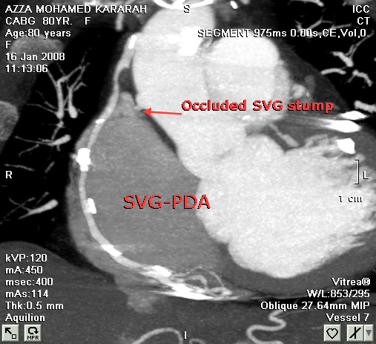

Slide 17
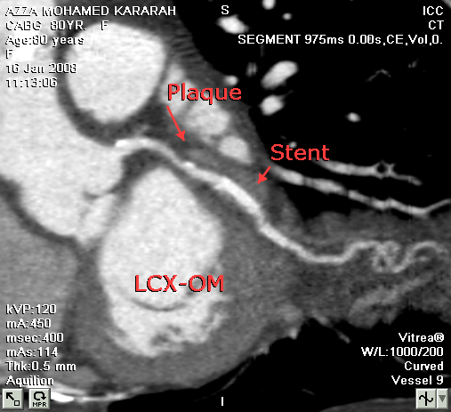

Slide 18
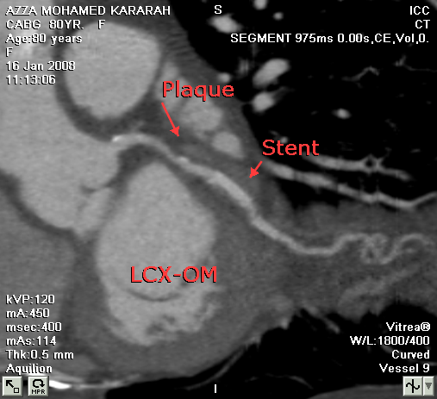

Slide 19
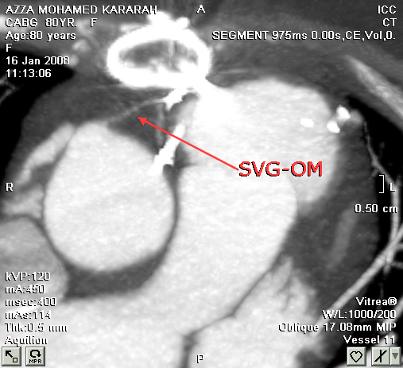

Slide 20
Post CTA coronary angiogram (5th )
PCI proximal RCA graft lesion
BM stent
LIMA angiogram (patent LIMA)
3 years angina free

Slide 21
Nov. 2011
Age: 85 ys
Good general condition
No Co morbid complications
2 weeks ago
acute coronary syndrome (NSTEMI)

Slide 22
CTA 64 MDCT
LAD: occlusive proximal disease.
LCX: patent stents.
Grafts:
LIMA– LAD patent.
SVG – RCA: proximal patent stent followed by occlusive mid segment lesion.
Associated dissecting left subclavian artery flap distal to LIMA origin extending up to left axillary artery.
Globally preserved LV function (EF 70%)

Slide 23
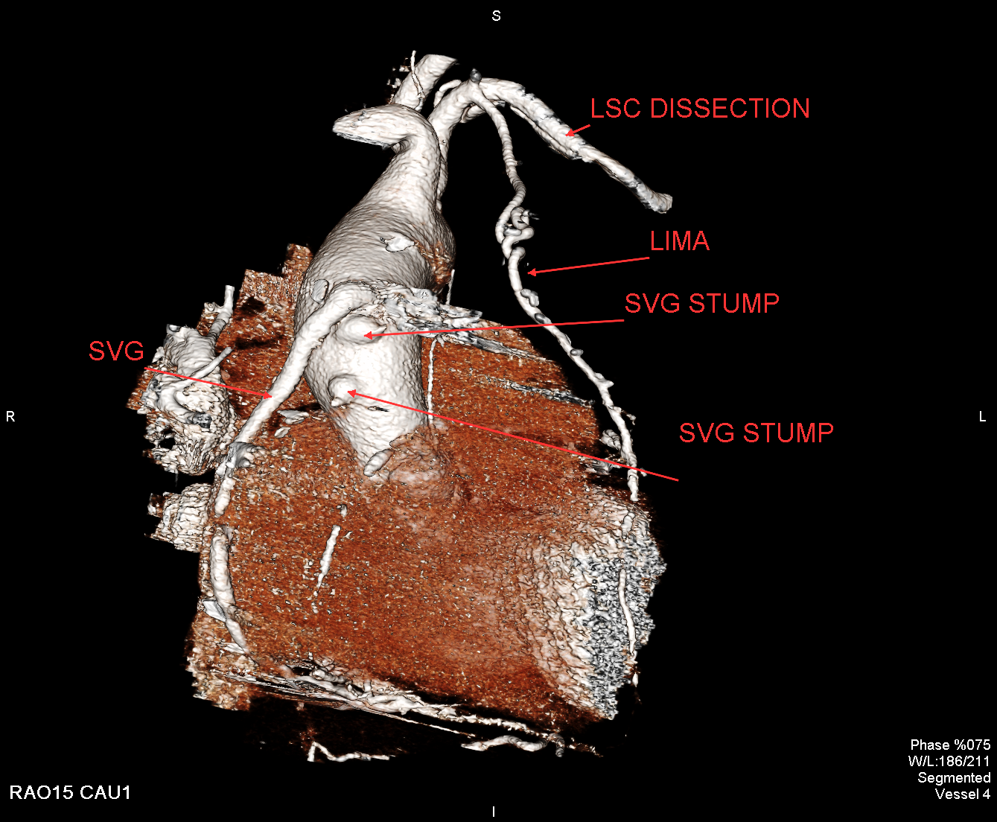

Slide 24
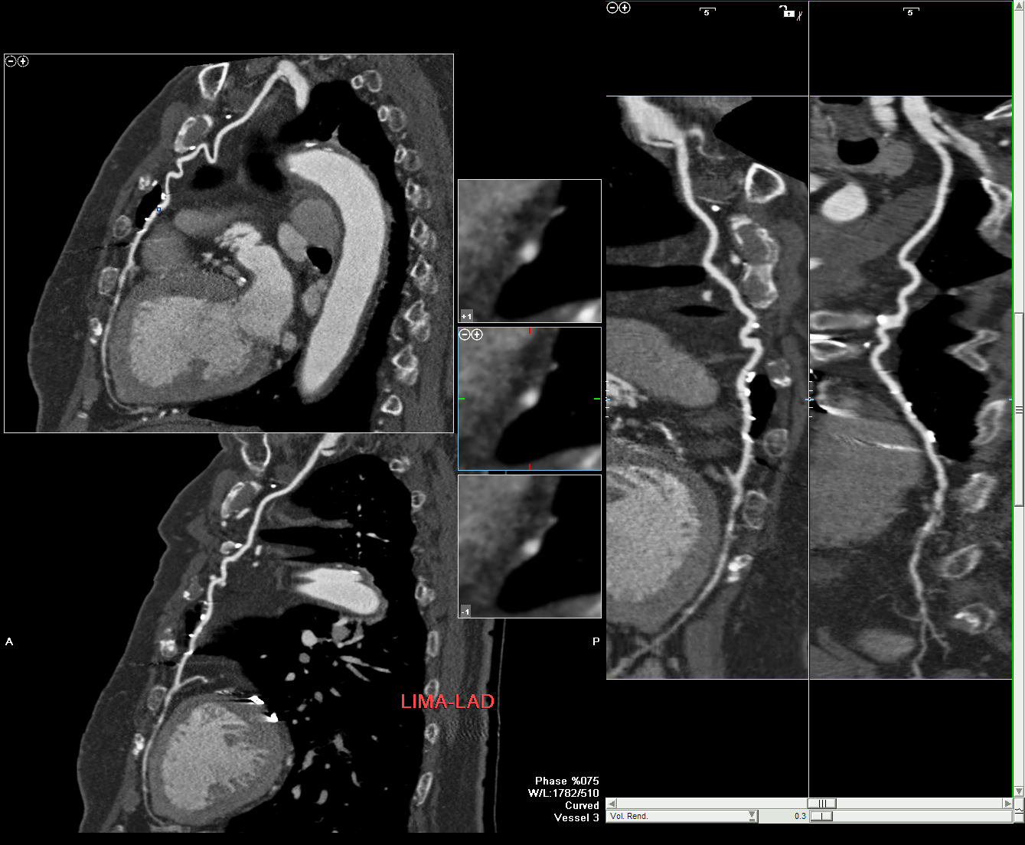

Slide 25
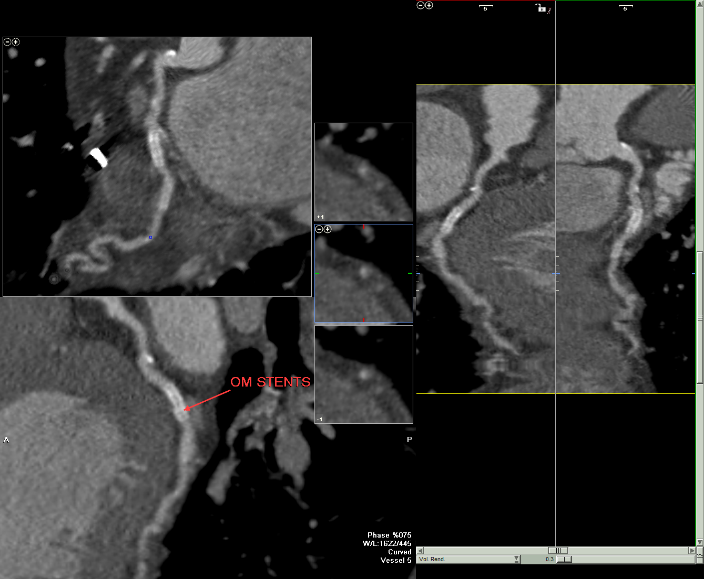

Slide 26
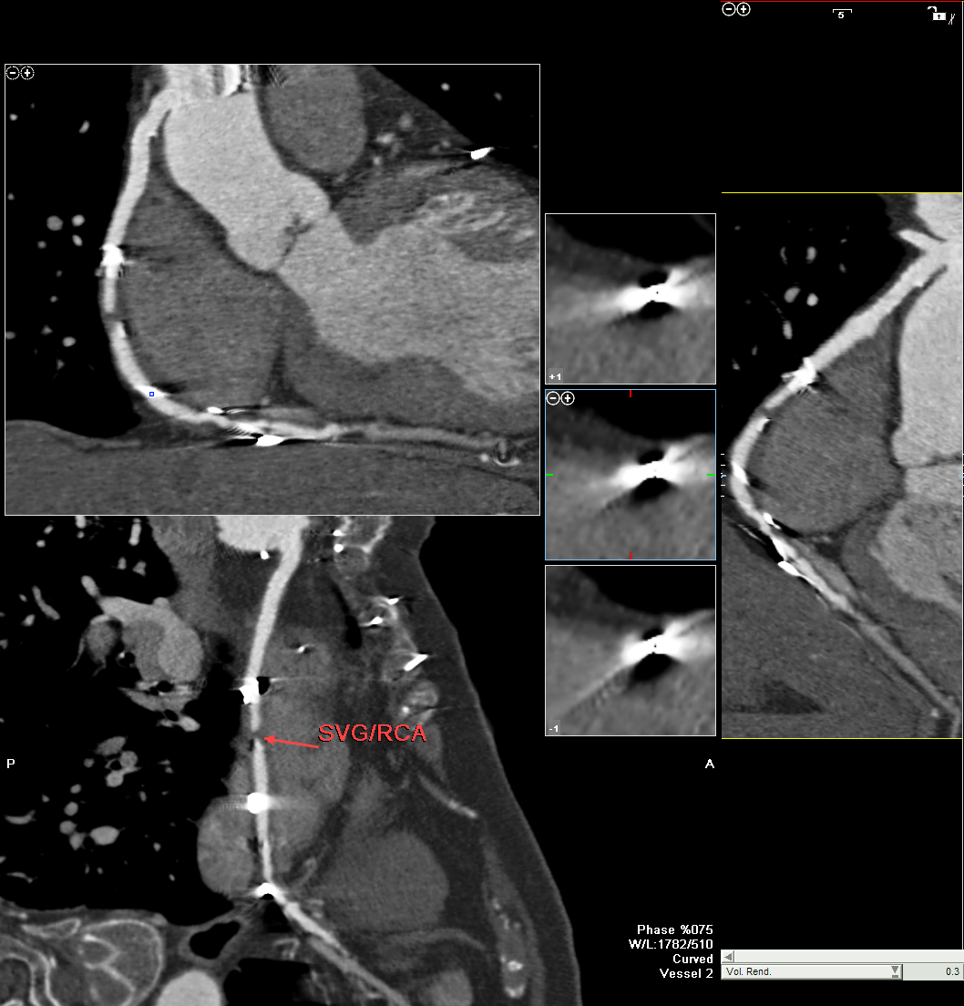

Slide 27
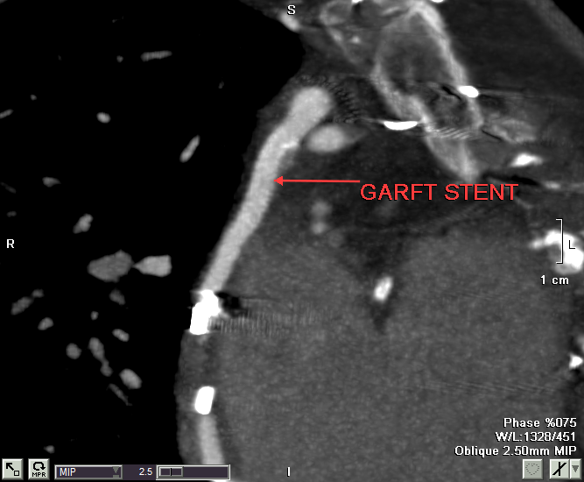

Slide 28
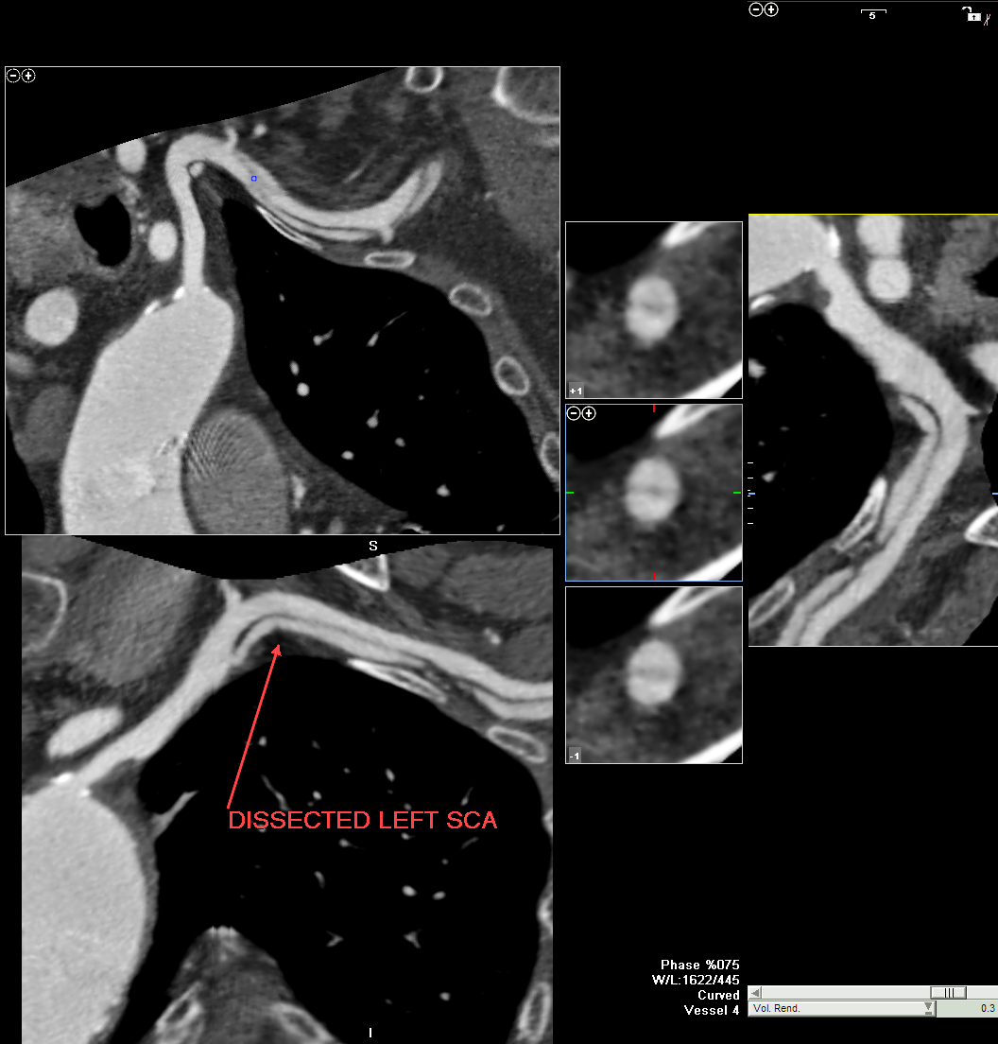

Slide 29
Post CTA coronary angiography (6th) PCI RCA graft with BM stent no attempt for LIMA angiogram

Slide 41
Take home messages
1. Proper assessment of patient with multiple risk factor(stress test – Ca. score – perfusion study )

Slide 42
1982
She had discovered
congenital absence of the left kidney.
Hypertension.
Dyslipidemia.
No chest pain on medical treatment
No further study

Slide 43
Comparison of a Sample of Global Coronary and Cardiovascular Risk Scores
 | Framingham | SCORE | PROCAM (Men) | Reynolds (Women) | Reynolds (Men)
Sample size | 5345 | 205,178 | 5389 | 24,558 | 10,724
Age, range (y) | 30 to 74; M:49 | 19 to 80; M:46 | 35 to 65; M:47 | >45; M:52 | >50; M:63
Mean follow-up (y) | 12 | 13 | 10 | 10.2 | 10.8
Risk factors considered | Age, sex, total cholesterol, HDL cholesterol, smoking, systolic blood pressure, antihypertensive Medications | Age, sex, total- HDL cholesterol ratio, smoking, systolic blood pressure | Age, LDL cholesterol, HDL cholesterol, smoking, systolic blood pressure, family history, diabetes, triglycerides | Age, HbA1C (with diabetes), smoking, systolic blood pressure, total cholesterol, HDL cholesterol, hsCRP, parental history of MI at <60 y of age | Age, systolic blood pressure, total cholesterol, HDL cholesterol, smoking, hsCRP, parental history of MI at <60 y of age
Endpoints | CHD (MI and CHD death) | Fatal CHD | Fatal/nonfatal MI or sudden cardiac death (CHD and CVD combined) | MI, ischemic stroke, coronary revascularization, cardiovascular death (CHD and CVD combined) | MI, stroke, coronary revascularization, cardiovascular death (CHD and CVD combined)
URLs for risk calculators | http://hp2010.nhlbi hin.net/atpiii/calcul ator.asp?usertype= prof | http://www.heartsc ore.org/pages/welc ome.aspx | http://www.chd- taskforce.com/co ronary_risk_asse ssment.html | http://www.reynoldsris kscore.org/ | http://www.reynoldsris kscore.org/

Slide 44
Recommended Approaches to Risk Stratification
ACC 2010
Cardiac and Vascular Tests for Risk Assessment

Slide 45
Recommendations for Resting Electrocardiogram
I
IIa
IIb
III
A resting electrocardiogram (ECG) is
reasonable for cardiovascular risk assessment
in adults with hypertension or diabetes.
A resting ECG may be considered for
cardiovascular risk assessment in
adults without hypertension or diabetes.
I
IIa
IIb
III

Slide 46
Recommendation for Transthoracic Echocardiogram
I
IIa
IIb
III
Echocardiography to detect left ventricular hypertrophy may be considered for cardiovascular risk assessment in adults with hypertension.
Echocardiography is not recommended for cardiovascular risk assessment of CHD in adults without hypertension.
B
I
IIa
IIb
III

Slide 47
Recommendation for Measurement of Carotid Intima-Media Thickness
I
IIa
IIb
III
Measurement of carotid artery intima-media thickness is reasonable for cardiovascular risk assessment in adults at intermediate risk. Published recommendations on required equipment, technical approach, and operator training and experience for performance of the test must be carefully followed to achieve high-quality results.
B

Slide 48
Recommendation for Brachial / Peripheral Flow-mediated Dilation
I
IIa
IIb
III
Peripheral arterial flow-mediated dilation studies are not recommended for cardiovascular risk assessment in adults.
B

Slide 49
Recommendation for Specific Measures of Arterial Stiffness
I
IIa
IIb
III
Measures of arterial stiffness outside of research settings are not recommended for cardiovascular risk assessment

Slide 50
Recommendation for Measurement of Ankle-Brachial Index
I
IIa
IIb
III
Measurement of ankle-brachial index is reasonable for cardiovascular risk assessment in adults at intermediate risk.
B

Slide 51
Recommendation for Exercise Electrocardiography
I
IIa
IIb
III
An exercise ECG may be considered for cardiovascular risk assessment in intermediate-risk adults (including sedentary adults considering starting a vigorous exercise program), particularly when attention is paid to non-ECG markers such as exercise capacity.
B

Slide 52
Recommendation for Stress Echocardiography
I
IIa
IIb
III
Stress echocardiography is not indicated for cardiovascular risk assessment in low- or intermediate-risk adults. (Exercise or pharmacological stress echocardiography is primarily used for its role in advanced cardiac evaluation of symptoms suspected of representing CHD and/or estimation of prognosis in patients with known CAD or the assessment of subjects with valvular heart disease.)

Slide 53
Recommendations for Myocardial Perfusion Imaging
I
IIa
IIb
III
Stress MPI may be considered for advanced cardiovascular risk assessment in adults with diabetes or asymptomatic adults with a strong family history of CHD or when previous risk assessment testing suggests high risk of CHD, such as a coronary artery calcium (CAC) score of 400 or greater.
Stress MPI is not indicated for cardiovascular risk assessment in low- or intermediate-risk adults. (Exercise or pharmacologic stress MPI is a technology primarily used and studied for its role in advanced cardiac evaluation of symptoms suspected of representing CHD and/or estimation of prognosis in patients with known coronary artery disease.)
I
IIa
IIb
III

Slide 54
Recommendations for Calcium Scoring Methods
I
IIa
IIb
III
Measurement of CAC is reasonable for cardiovascular risk assessment in adults at intermediate risk (10% to 20% 10-year risk.
Measurement of CAC may be reasonable for cardiovascular risk assessment persons at low to intermediate risk (6% to 10% 10-year risk).
Persons at low risk (<6% 10-year risk) should not undergo CAC measurement for cardiovascular risk assessment.
B
I
IIa
IIb
III
B
I
IIa
IIb
III
B

Slide 55
Recommendation for Coronary Computed Tomography Angiography
I
IIa
IIb
III
Coronary computed tomography angiography is not recommended for cardiovascular risk assessment .

Slide 56
Recommendation for Magnetic Resonance Imaging of Plaque
I
IIa
IIb
III
Magnetic resonance imaging for detection of vascular plaque is not recommended for cardiovascular risk assessment .

Slide 57
Take home messages
2. CTA (non invasive) vs coronary angio (invasive)
Repeated invasive coronary angiography increase risk of complication (subclavian dissection)

Slide 58
Risk Assessment Post-revascularization (PCI or CABG)
Indication |  | Appropriate Use
Symptomatic (Ischemic Equivalent)
 | • Evaluation of graft patency after CABG | A
 | • Prior coronary stent with stent diameter <3 mm or not known | I
 | • Prior coronary stent with stent diameter 3 mm | U
Asymptomatic—CABG
 | Time Since CABG | <5 y Ago | 5 y Ago
 | • Prior CABG | I | U
Asymptomatic—Prior Coronary Stenting
 | • Prior left main coronary stent • Stent diameter 3 mm | A

Slide 59
Iatrogenic SCV artery dissection Only 6 cases in literature 3 1995 1 1998 2 2010

Slide 60
Take home messages
3. CABG vs DES.
CABG Arterial vs venous graft.

Slide 61
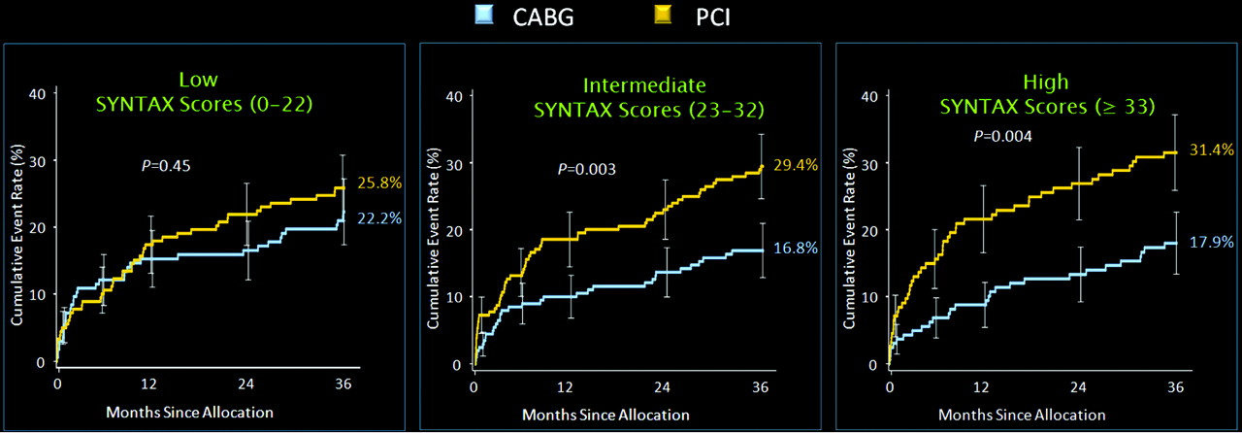
Cumulative incidence of MACE in patients with 3-vessel CAD based on SYNTAX score at 3-year follow-up in the SYNTAX trial treated with either CABG or PCI. CABG indicates coronary artery bypass graft; CAD, coronary artery disease; MACE
et al. Circulation 2011;124:e574-e651
Copyright © American Heart Association
Notes:
Cumulative incidence of MACE in patients with 3-vessel CAD based on SYNTAX score at 3-year follow-up in the SYNTAX trial treated with either CABG or PCI. CABG indicates coronary artery bypass graft; CAD, coronary artery disease; MACE, major adverse cardiovascular event; PCI, percutaneous coronary intervention; and SYNTAX, Synergy between Percutaneous Coronary Intervention with TAXUS and Cardiac Surgery. Adapted with permission from Kappetein.46

Slide 62
Intraoperative Considerations
Bypass Graft Conduit

Slide 63
Bypass Graft Conduit
If possible, the LIMA should be used to bypass the LAD artery when bypass of the LAD artery is indicated.
The right IMA is probably indicated to bypass the LAD artery when the LIMA is unavailable or unsuitable as a bypass conduit.
I
IIa
IIb
III
B
I
IIa
IIb
III

Slide 64
When anatomically and clinically suitable, use of a second IMA to graft the left circumflex or right coronary artery (when critically stenosed and perfusing LV myocardium) is reasonable to improve the likelihood of survival and to decrease reintervention.
Complete arterial revascularization may be reasonable in patients ≤60 years of age with few or no comorbidities.
I
IIa
IIb
III
B
I
IIa
IIb
III

Slide 65
Arterial grafting of the right coronary artery may be reasonable when a critical (≥90%) stenosis is present.
Use of a radial artery graft may be reasonable when grafting left-sided coronary arteries with severe stenoses (>70% diameter) and right-sided arteries with critical stenoses (≥90%) that perfuse LV myocardium.
I
IIa
IIb
III
B
I
IIa
IIb
III
B

Slide 66
An arterial graft should not be used to bypass the right coronary artery with less than a critical stenosis (<90%).
I
IIa
IIb
III
Harm

Slide 67
Take home messages
4. Despite all this event management of patient provided good LV function with no co morbidity

Slide 68
Thank You

Slide 69
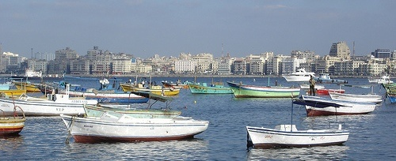
Prof Dr. Magdy Rashwan Dr.Yasser Morsy

